Slide 1
ADVANCE DRIVING SCHOOL MANAGEMENT SYSTEM
GROUP-1

Slide 2
TEAM MEMBERS
EMPLOYEE ID | NAME
2498952 | M S HARISH (TEAM LEAD)
2498470 | GURRAMKONDU VINAY KUMAR (FRONTEND LEAD)
2498878 | SNEHA DADASAHEB RAJMANE (BACKEND LEAD)
2498232 | SOUVIK GANGULI
2498433 | SUKANYA RAJU KONAR
2498998 | MEKALA VENKATA SAI PAVAN KUMAR REDDY
2499293 | NANDAM KIRANMAYI
2498650 | ANIL KASHIRAM PATIL
2498899 | VISHAL S P
2498704 | MUNJA SATHVIKA

Slide 3
INDEX
Introduction
Spring
Angular
Project Scope
Flow chart
Tools & Technologies
Admin & Student modules
Functional specifications
Schema

Slide 4
Introduction
This Advanced Driving School Management system can reduce the efforts of human power and ensure the driving school-training information resource to be utilized effectively.
It ensures driving-training school’s information resource to be utilized effectively.
It is a web-based application for maintaining records of car and the students training in this school. It will maintain the record of entire students at driving school.
This application automates manual tasks by managing all records of student’s admission, Attendance, vehicles and trainers.
The system is easy, efficient and reliable to use.

Slide 5
SPRING
Spring is an open source layered Java/J2EE application framework
Spring Boot is an awesome Java framework to build RESTful API and Microservices
Very loosely coupled, components widely reusable and separately packaged.
Spring allows to decouple software layers by injecting a components dependencies at runtime rather than having them declared at compile time via importing and instantiating classes.
Spring is built on the principle of unchecked exception handling. This also reduces code dependencies between layers.
Spring provides a granular exception hierarchy for data access operations and maps JDBC, EJB, and ORM exceptions to Spring exceptions so that applications can get better information about the error condition

Slide 6
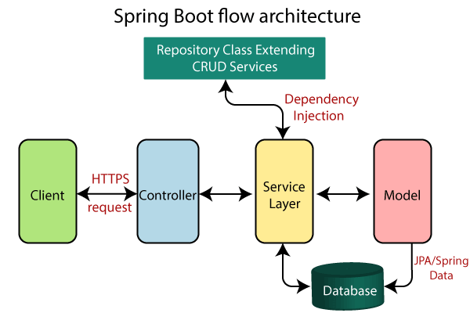
SPRING

Slide 7
ANGULAR
Angular is a Framework of JavaScript used to build web and mobile applications.
Angular is a reusable UI component helps us constructing attractive, consistent, and functional web pages and web application.
AngularJS is a JavaScript framework which makes us able to create an attractive Single Page Applications (SPAs).
In Angular programming language, the elementary building blocks are NgModules, which deliver a compilation environment for components.
Angular generates UI with simple and authoritative templates syntax.
Angular can be used as a cross platform approach.

Slide 8
PROJECT SCOPE
To develop a system that will allow driving schools electronically record student’s information.
This system will serve as a repository of the student’s record enrolled for driving lesson.
This system helps to schedule the lessons for students.
This application automates manual tasks by managing all records.
The system is easy, efficient and reliable to use.
Driving Instructors - By having the system they can easily track students who are scheduled for a driving session. They can easily look for updates and communicate with their students.

Slide 9
Project Highlights
The Driving School Management System is a database driven system that will automate the processes such as recording, keeping and updating information related to the driving school and its students.
Automated recording and keeping – this system will make it easier for the school management to handle all information of students and other records of the schools.
Records Management – it is a database system which makes the records of the schools and students electronic, safe, accurate, reliable and fast.

Slide 10



TOOLS AND TECHNOLOGIES
Front-End : Angular
Server-Side : Spring-Boot
Back-End : MYSQL, Hibernate.
Server : Tomcat-9.0

Slide 11
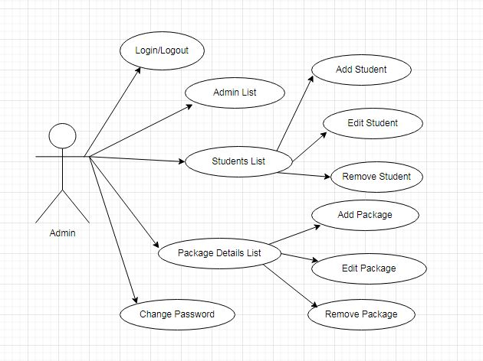
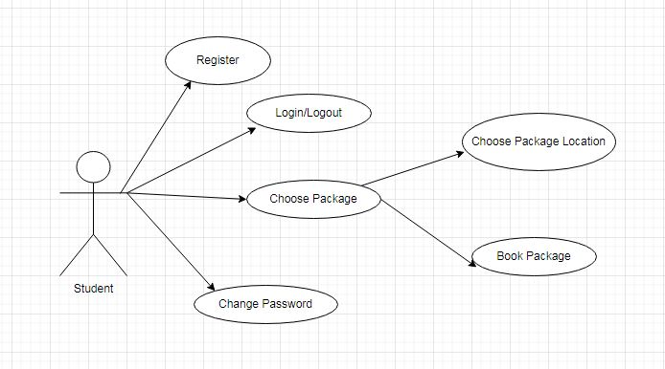
SCHEMA

Slide 12
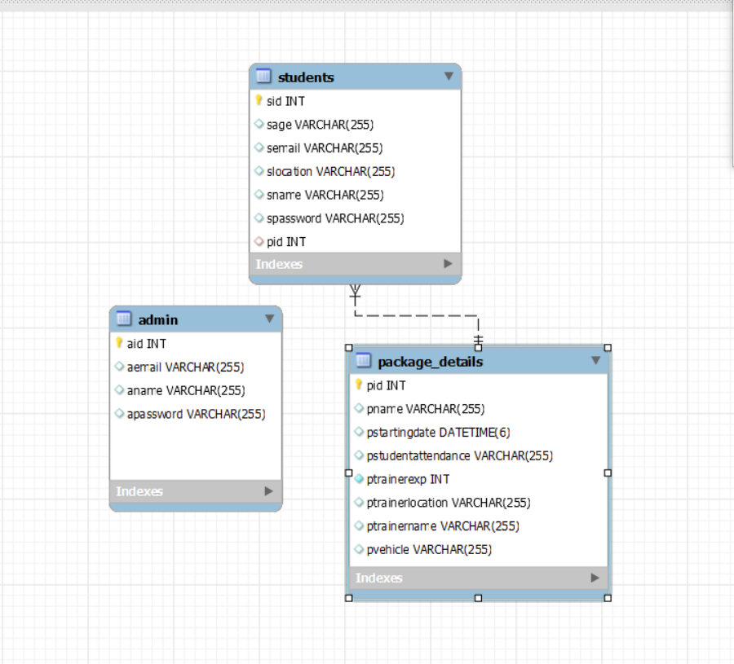
SCHEMA

Slide 13



MODULES
ADMIN
STUDENT

Slide 14
ADMIN MODULE
Login to the portal and this dashboard serves as the homepage of the administrator.
Manage the records of student’s admission, attendance, vehicles,and trainers.
Maintain the record of entire students at driving school
Two admins are assigned for the work in the absence one, another can handle the process.
View enrolled students – master list of students.
Provide grades or progress report to students.

Slide 15
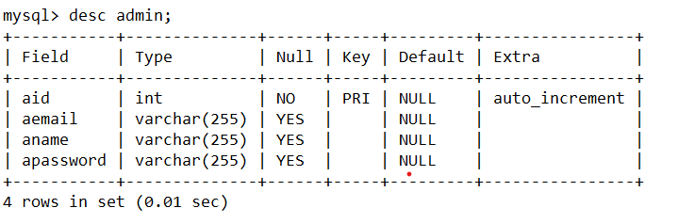
ADMIN MODULE

Slide 16
STUDENT MODULE
Register and Login to the portal and this dashboard serves as a homepage of the students registered as students in the system.
Once Login see basic training tutorials accessible on the portal.
Students are also divided into two types, local students and remote student.
Local students can register and select the package and timing, for remote student they can check for the nearby remote trainer.

Slide 17
STUDENT MODULE
Login Form – the login form will be used by the intended users of the system to log in to the system. Each of them will have their unique username and password to be able to access the records and features of the system.
Registration Form – this form is intended for registration. The user of the system will filled out the required information in order to register in the system.

Slide 18
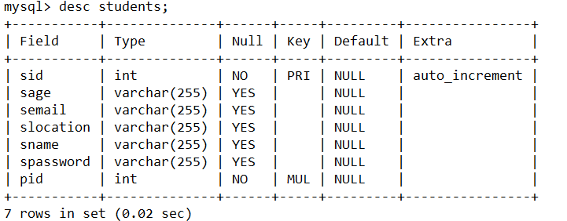
STUDENT MODULE

Slide 19
ANNOTATIONS USED
Request Mapping
Auto Wired
Post Mapping
Get Mapping
Delete Mapping
Put Mapping

Slide 20
FUNCTIONAL SPECIFICATIONS
Login | Logout:-
Go to Registration screen when you click on Register link.
Go to Success screen when you login successfully after entering valid username & password fetched from the database.
Redirect back to same login screen if username & password are not matching.
Implement Session tracking for all logged in users before allowing access to application features. Anonymous users should be checked, unless explicitly mentioned.

Slide 21
FUNCTIONAL SPECIFICATIONS
Admin list:-
Admin can edit,update,delete the details of the students.
Admin can view the entire list of the students who are undergone the training
Students list:-
Data of the students will be displayed
Students can select the package and the schedule in which they are willing to undergo training

Slide 22
CONCLUSION
This Advanced Driving School Management system can reduce the efforts of human power.
This application automates manual tasks by managing all records of student’s admission, Attendance, vehicles,and trainers.
The data loss can be avoided and we can resuse the data at any time.

Slide 23
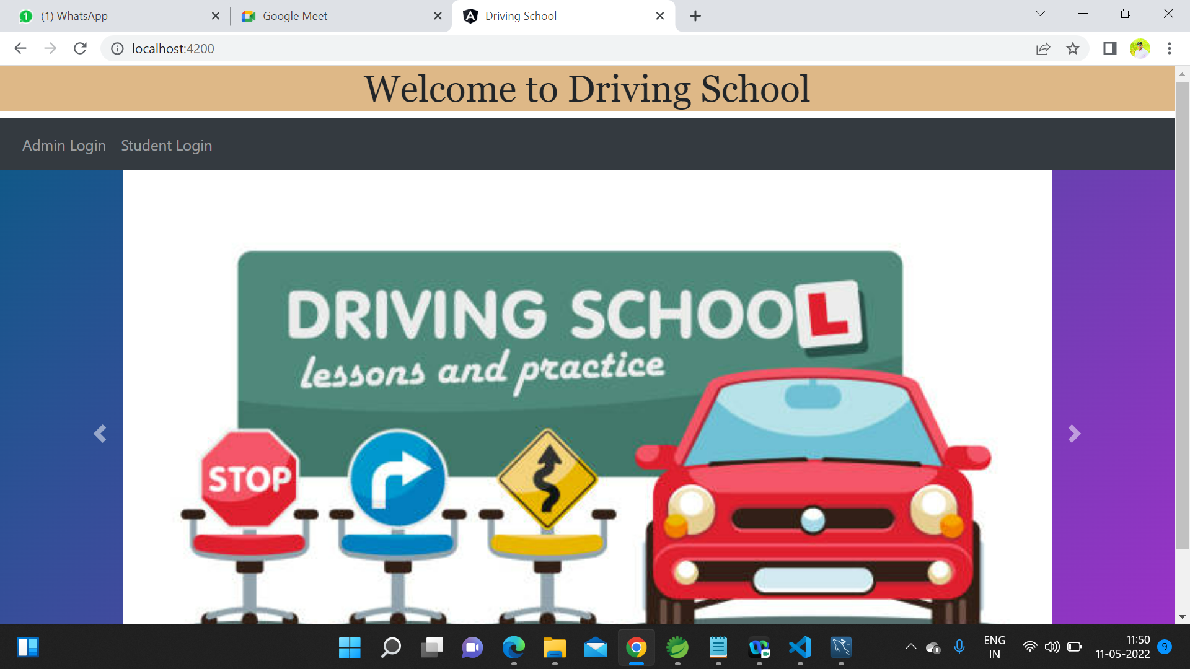
OUTPUTS

Slide 24
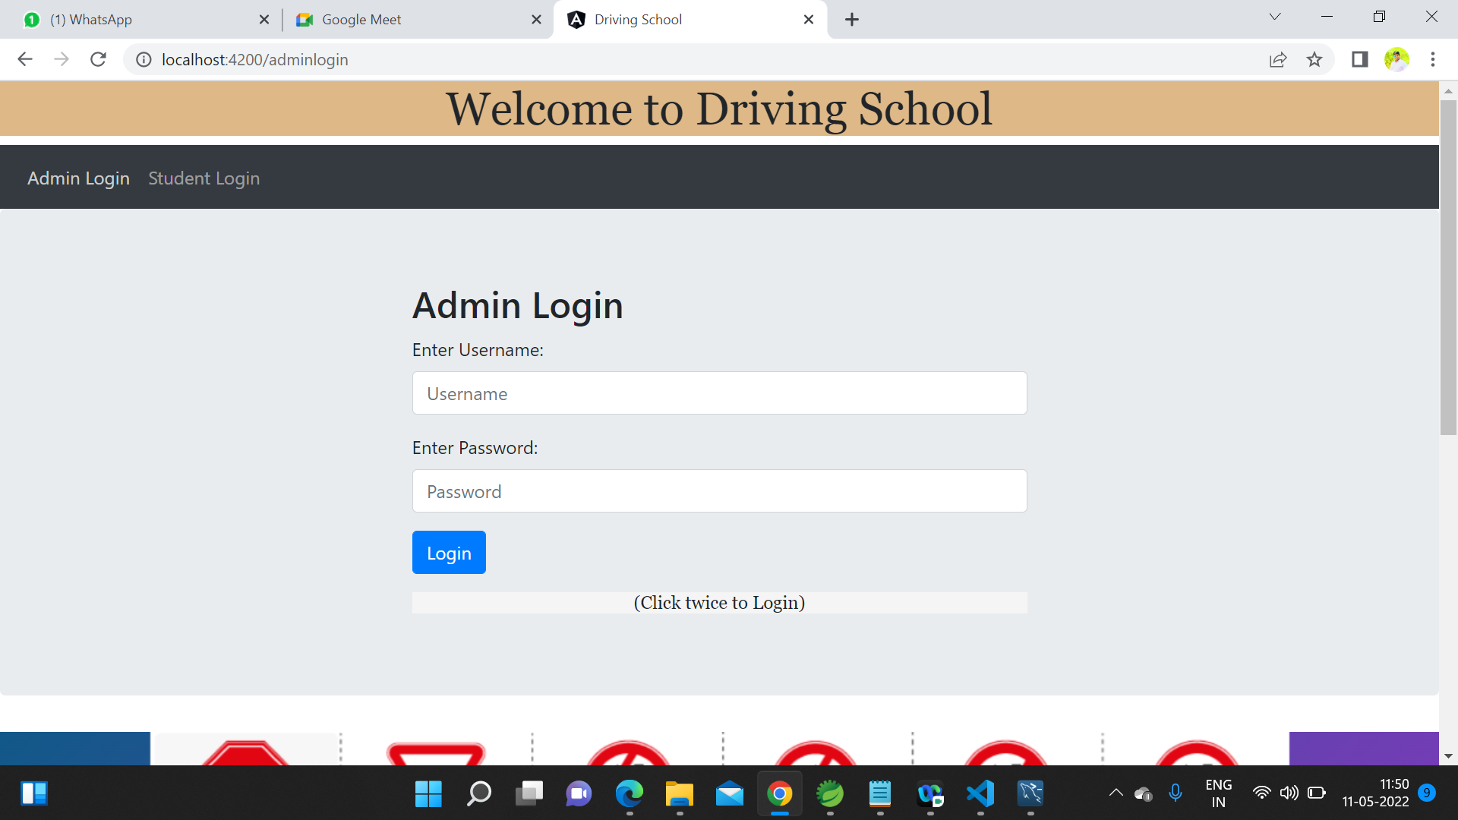

Slide 25
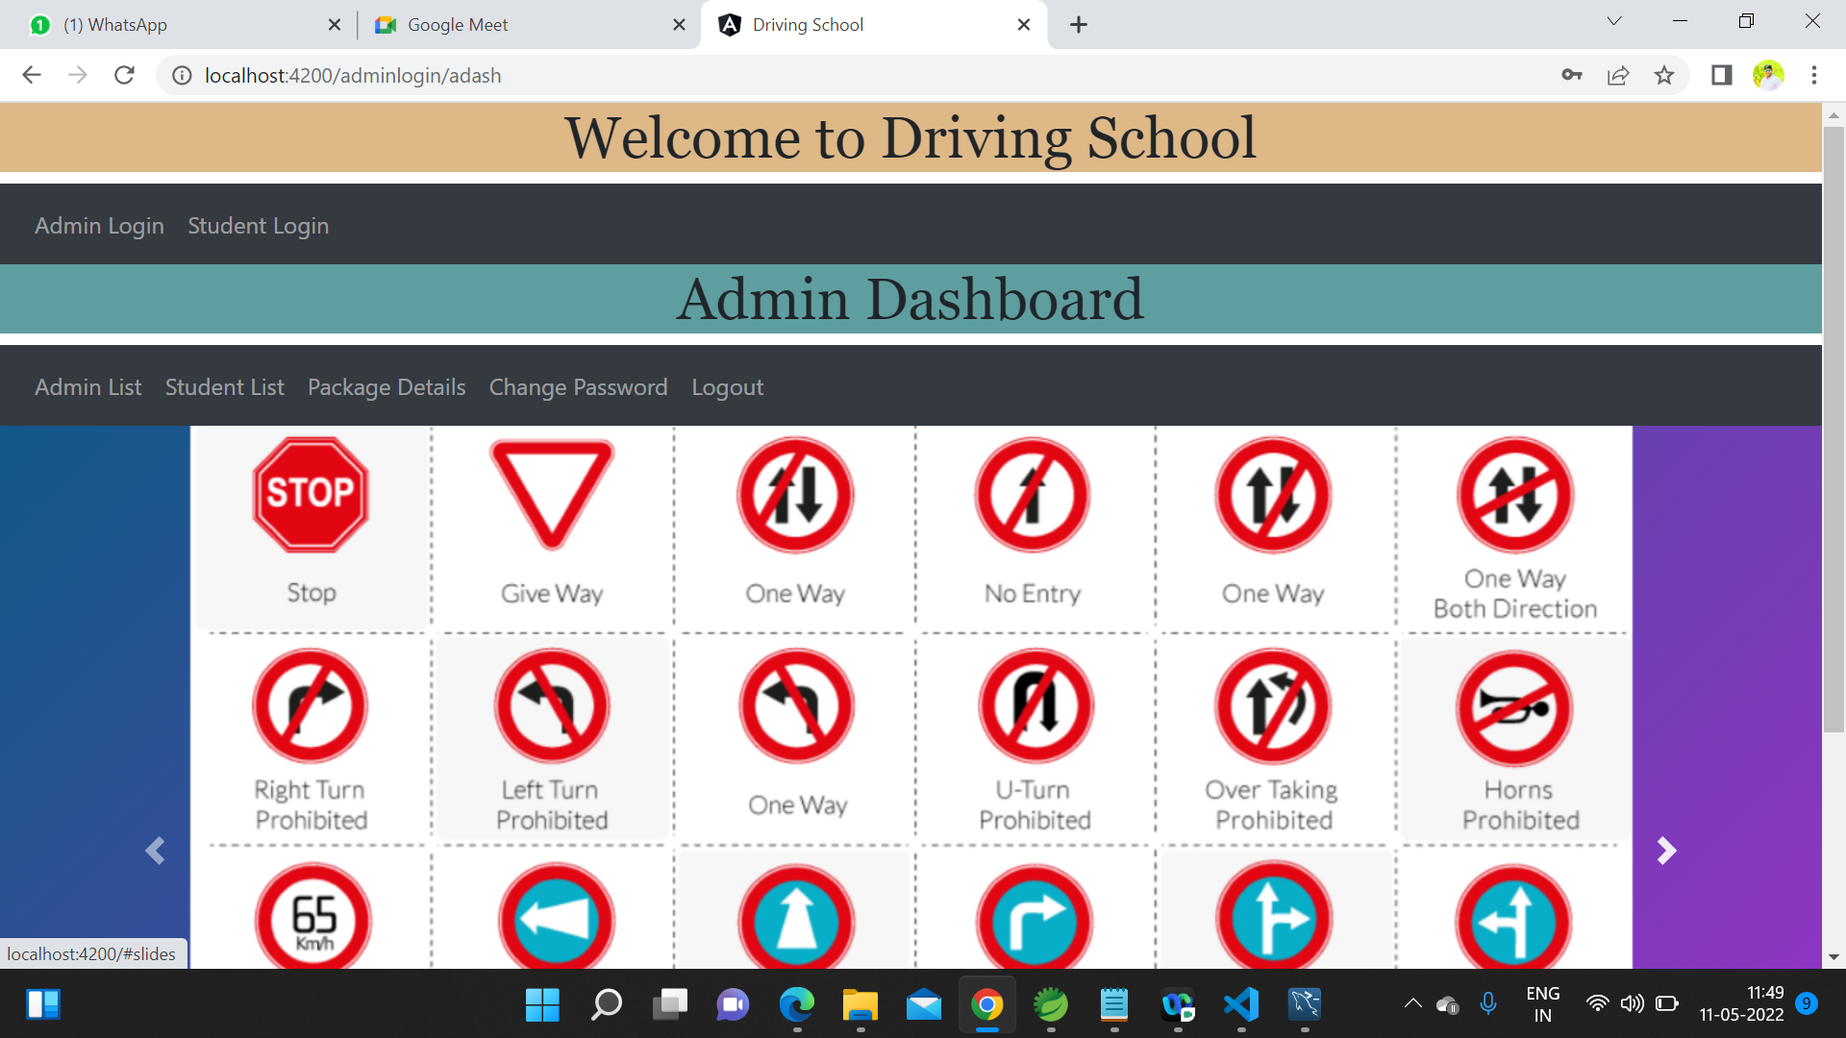

Slide 26
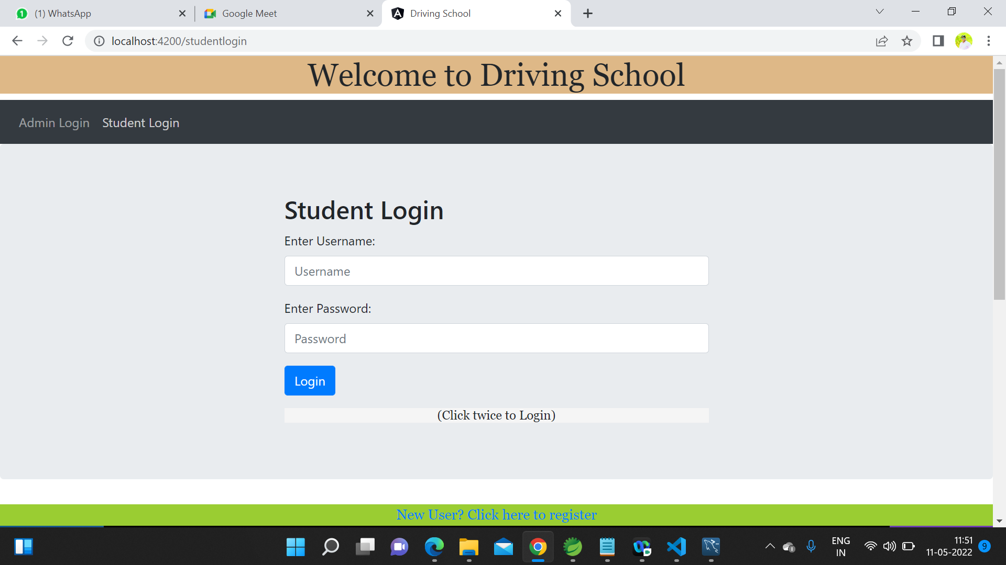

Slide 27
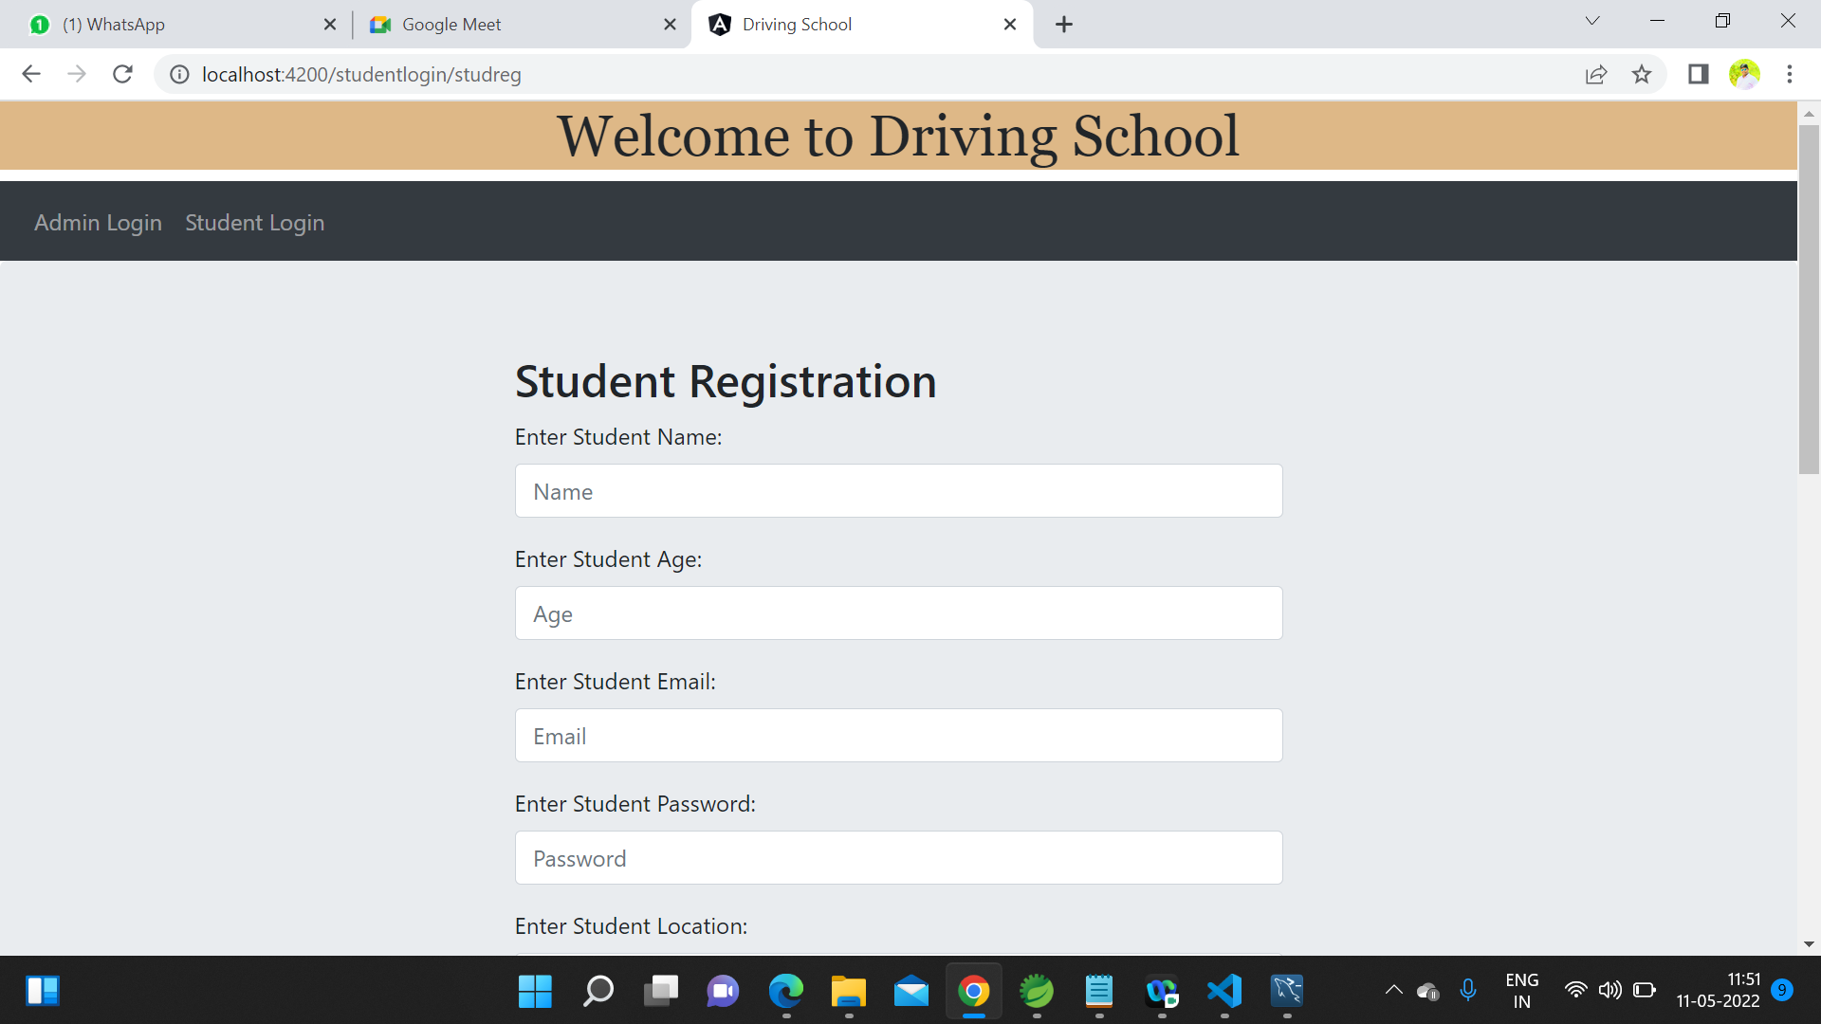

Slide 28
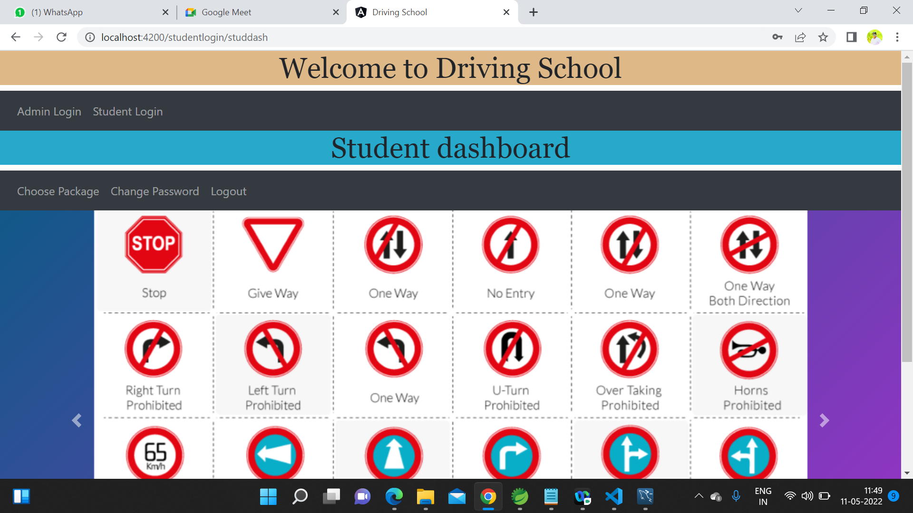

Slide 29
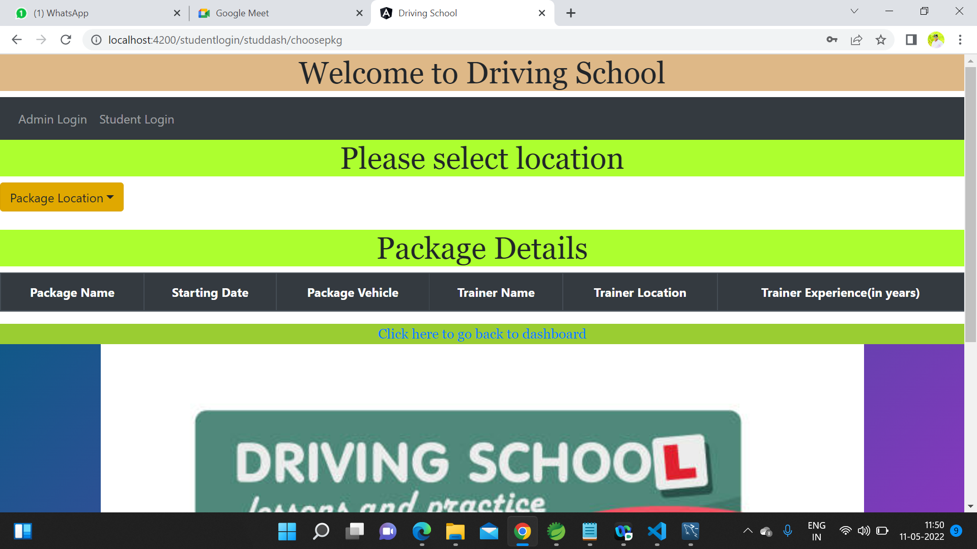

Slide 30
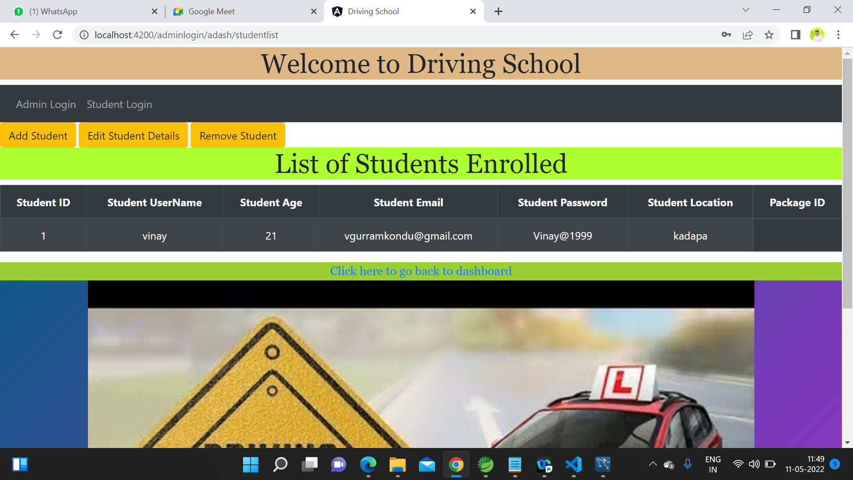

Slide 31


